Slide 1
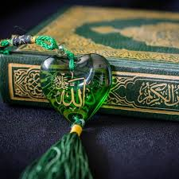
The seven Dialects of reciting quran

Slide 2
Prophet ﷺ said:
" إ نَّ هَذَا الْقُرْآنَ أُنْزِلَ عَلَى سَبْعَةِ أَحْرُفٍ فَاقْرَءُوا مَا تَيَسَّرَ مِنْهُ ‏" (صحیح البخاری،باب ان القران علی سبعۃ احرف)
The Qur'an was sent down in seven dialects. So recite what seems easy therefrom.
Interpretation of the seven dialects:
The seven dialects refers to the variations in the recital of the Quran of seven kinds.

Slide 3
Seven kinds of recitation
Variation in nouns(numbers or Genders) لا یقبل ،لا تقبل- وتمت کلمۃ ،وتمت کلمات
Variation in Tenses ربنا باعِد بین اسفارنا،ربنا بعُد بین اسفارنا
Variation of diacritical marks ذوالعرشِ المجیدِ، ذوالعرشِ المجیدُ
Variation caused by omission & addition وماخلق الذکر والانثی، والذکر والانثی
Variation in placement of word وجائ ت سکرۃ الموت بالحق، وجائ ت سکرۃ الحق بالموت
Variation caused by replacement of letter ننشرھا،ننشزھا
Variation of accent like “Imala,Md,etc” بسم اللہ مجراھا

Slide 4
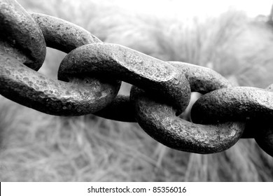
Preservation of holy quran In prophet ﷺ Era in Abu Bakar Siddique ؓ Era In usman e ghani ؓ era

Slide 5
In the time of prophet ﷺ
لَا تُحَرِّكۡ بِهٖ لِسَانَكَ لِتَعۡجَلَ بِهٖ انَّ عَلَيۡنَا جَمۡعَهٗ وَقُرۡاٰنَهٗۚ
(O Prophet,) do not move your tongue (during revelation) for (reciting) it (the Qur’ān) to receive it in hurry. It is surely undertaken by Us to store it (in your heart), and to let it be recited (by you after revelation is completed).
Preserved by hearts(بیر معونہ,70 huffaz)
Through inspirational writers (kaatibeen-e-Wahi, 40) 4 Caliphs, Zaidbin Sabit, Ubai bin Kab, Aban bin Saeed etc..(on stones, parchments of leather )

Slide 6
In caliphate of ABU BAKR SIDDIQUE
Reasons
Copies of whole Quran were very few
Commonly Surah's were written separated, Some had one surah, while others had another.
Incident of “Yamama” battle in which a big quantity of Huffaz has been mitered
The method used by Syyed Zaid bin Sabit ؓ
Verification from his own memory
Checked by Hazrat Umer,ؓ because he was also Hafiz
Confirmation by two reliable witnesses on written Ayah …
Matched with the collections of different companions & their memories

Slide 7
Features of “Umm” (ام)
The compilation of Mus'haf in Abu Bakar Siddique era called “Umm”
The Quranic verses were arranged in the order specified by the Prophet ﷺ.
Surahs’ were not arranged, they were written separately.
All seven dialects were incorporated into this version.
Only those verses were included whose recital wasn’t abrogated.
The motive for compiling "Umm" was to prepare the authenticated copy with the unanimous support of the entire nation.(امت کی اجماعی تصدیق کے ساتھ)

Slide 8
In usman e ghani ؓ era
Reason
Islam had spread to remote areas. People embracing Islam used to learn Quran through different soldiers or traders.
Each companion taught the Qur'an according to his particular recital.
Seven letters couldn't gain the necessary publicity in these new Muslims.
Due to unfamiliarity with the seven letters, people started calling their recitation correct and the other's recitation incorrect.
Hazrat Uthman, in consultation with the great Companions, took the step for agreeing Muslims on one Mushaf

Slide 9
Its Features & steps taken
Surahs arranged in a proper sequence and they were brought together in one single script.
The script was adopted in such a way that all the recitations could be recited continuously, so no punctuation and dots were used.
Several(seven) transcripts of the freshly written copied were prepared and were sent to seven different cities & countries.
All precautions which were carried out during the reign of Siddiq E Akbar had been taken.
All individually prepared transcripts has been burnt to become one uniform agreed transcript in future.

Slide 10
جزاکم اللہ خیرا

